Slide 1


Welcome to
Technically Speaking:
Framing and Presenting a
Simple and Compelling Story
Brown Bag Seminar
William G. Rhodes III
Sandia National Laboratories is a multi-program laboratory managed and operated by Sandia Corporation, a wholly owned subsidiary of Lockheed Martin Corporation, for the U.S. Department of Energy’s National Nuclear Security Administration under contract DE-AC04-94AL85000.
Notes:
I had trouble thinking of an adequate title. It should have said something about my personal journey to Framing and Presenting a Simple and Compelling Story
Started in 1982, speaking in Las Vegas on my thesis work. The talk was awful, cause I had no idea what I was doing.
I resolved at that point to get better, to be among the best. Today I’m going to tell you about my 30 year effort to be a better technical speaker.
Second, I’ve noticed a trend that other Labs in my area of management responsibility were doing a better job with their presentations, and being very competitive, I wanted Sandia to have the best presentations.
I know we can do better, and I hope you’ll join in my continuing journey to improve our presentations.
Last, I have some solutions and ideas for you to consider. These thoughts are immediately actionable, things that you can take with you today and think about and put into practice.

Slide 2
A CONVERSATION about PowerPoint
Notes:
Here is the agenda for today’s discussion. We’ll start with a conversation about PowerPoint.
I don’t mean to pick on PowerPoint, it could be any software used to assist with presentations, like Apple’s Keynote.
This part of my presentation will be interactive with you.

Slide 3
A CONVERSATION about PowerPoint
PLANNING a presentation
Notes:
Next we’ll discuss how to properly plan a presentation.

Slide 4
A CONVERSATION about PowerPoint
PLANNING a presentation
PREPARING a great presentation
Notes:
Last, we’ll discuss preparing a great presentation.

Slide 5
A CONVERSATION about PowerPoint
Notes:
So, let’s have an honest discussion about PowerPoint.

Slide 6
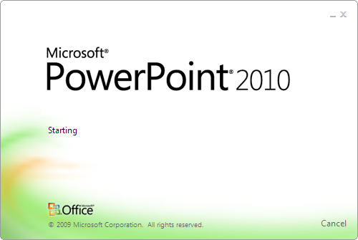
What comes to mind when you think of PowerPoint?
CONVERSATION
PLANNING
PREPARING
Notes:
One word answers from the audience

Slide 7
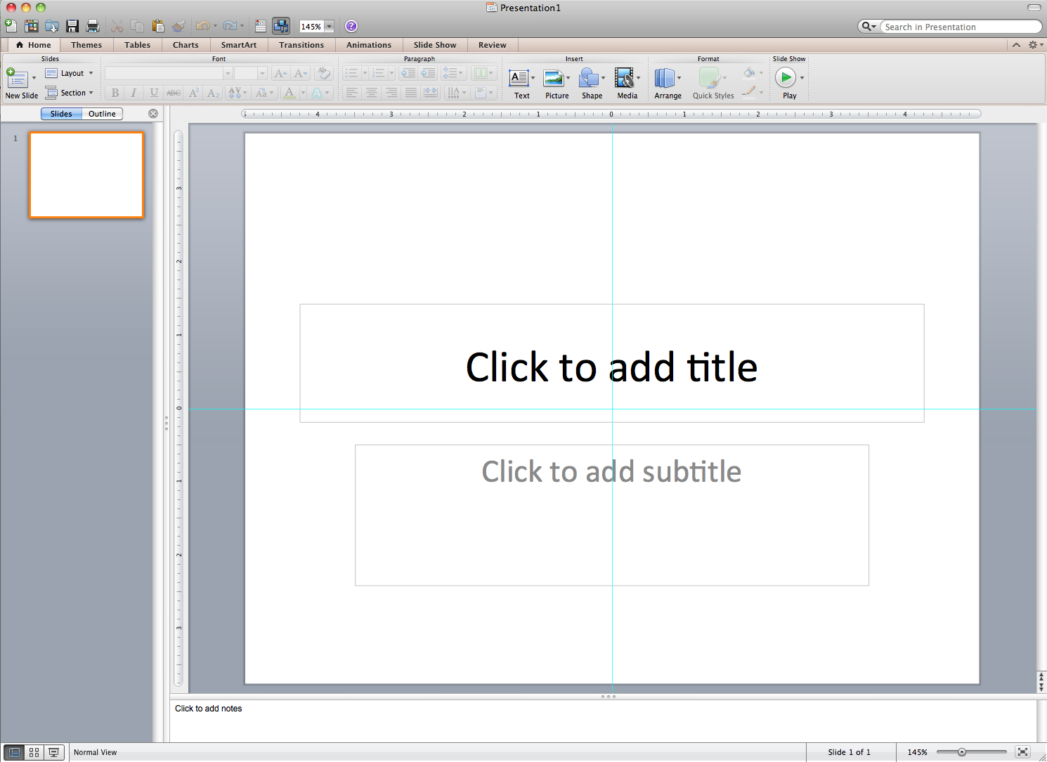
What do you intend to do with PowerPoint?
CONVERSATION
PLANNING
PREPARING
Notes:
In short, people say that they use powerpoint to accomplish the most important work they do, both at an individual and at an organizational level. From the strategic to the tactical, you probably use powerpoint to persuade, make decisions, explain, tell your stories, and document intellectual assets. From the quarterly report to the sale of a company to the opening statement of a trial to the policies and proposals of government, powerpoint is center stage today. It’s no wonder all of us demand a great deal from a software tool.

Slide 8

How can PowerPoint negatively impact the relationship between audience and presenter?
People
Information
CONVERSATION
PLANNING
PREPARING
Notes:
“reading the slides!” this is the most common response, along with “e-mail it to me!” and “a transcript!” and “Just give me the handout and save us both some time!” For a tool that was supposed to help us present more effectively to one another, many people would rather not be there at all than endure someone reading bullet points to them, and that is especially “Frustrating!” because people don’t know whether they should look at the text on the slide or at the speaker.
The Information Issues
“a Crutch!” people say this frequently, or “hide behind it!” or “the speaker’s cheat sheet!” these are tough words for any speaker to hear, especially if you know that audiences automatically expect you to be “unprepared,” “lazy,” and ultimately “disappointing.”
“lose their personality!” You might want to be natural and relaxed when you present, but people say that bullet points make the atmosphere formal and stiff and “unnatural” with “no spontaneity.” Worse, people say that speakers “overcom- pensate” by adding animations and special effects to divert attention away from their own lack of organization, rehearsal, or speaking skill.
“antisocial!” people say that conventional powerpoint presentations leave audiences feeling detached and disconnected from the others in the room. Many people today aim for a more collaborative and conversational presentation, yet in reality, the results are “Silencing!” or “One way!” or “Condescending!” or even “Dominating!” In no uncertain terms, audiences are saying to presenters that the conventional powerpoint approach diminishes your public speaking ability and degrades the relationship between you and them.
“too simplistic!” people often say this, along with “dumbed down” and “makes me feel like a second grader.” It’s not only in workshops like mine that people are saying they are frustrated with the conventional bullet points approach. they’re expressing themselves in a wide range of forums, including discussion groups, surveys, books, essays, articles, and blog postings.
“data dump!” But more often than intellectual underload, people complain about cognitive overload in powerpoint presentations. “too complex!” they say, and the presentations can be “overwhelming,” with too much raw information. the use of bulleted lists comes across as “wordy,” which can lead to a presentation that “never ends” and that is “forgettable.”
“no story!” people say that powerpoint presentations are “a jumble” of “incoher- ent lists” without context, with “no direction” and “no conclusion.” people say thatVisual Improvisation
they’re not clear about what they’re supposed to do with the information as they ask, “What’s the point?” and find that the information is “not results-oriented,” practical, or applicable.
“Frankendeck!” people say that powerpoint presentations can be like a Franken- stein monster—a “mish-mash” of slides filled with “pointless graphics” and “crazy colors” with “unreadable” text that “looks horrible” and is ultimately “bad design.” people report that their organizations spend a great deal of time, money, and emotional energy on powerpoint presentations with only “low-grade output.”

Slide 9
GROUP ACTIVITY
Notes:
When I start the PowerPoint presentation, one of the images on the PowerPoint slides will appear on screen. I’ll begin the exercise as the first speaker by looking at the image and using it as a prompt to start the story, somehow weaving the subject of the image into my narration. The image will stay on screen for 30 seconds, and then it will fade away and a new slide will appear. That’s my cue as the current speaker to sit down, and also the cue for the next person in line to stand up. That person now has to improvise on the new image as he or she continues the story for the next 30 seconds. Each image will be a surprise to each speaker, so you will have to think on your feet and plumb the depths of your creativity and wit to integrate the image into your narration. After the 30 seconds, the image automatically advances, and that person sits down while the next person stands and continues the story by improvising on the new image.

Slide 10

Notes:
It’s Monday morning of next week, and you arrive at your desk, sip your cup of coffee, and open your e-mail program. You see an e-mail message marked Urgent with a Subject line that reads, “Major Announcement.” You think this is strange, because the Address line says that the message is from the board of directors, and you’ve never seen them send an e-mail message directly to the entire organization. As you read the message, the board explains that it has had a top-secret initiative in the works for a year, which they now can announce officially today. This is a major change from the way the organization currently does business, and it will have a significant impact on every single person. The e-mail message explains what is going to happen next . . .

Slide 11


Slide 12


Slide 13


Slide 14


Slide 15
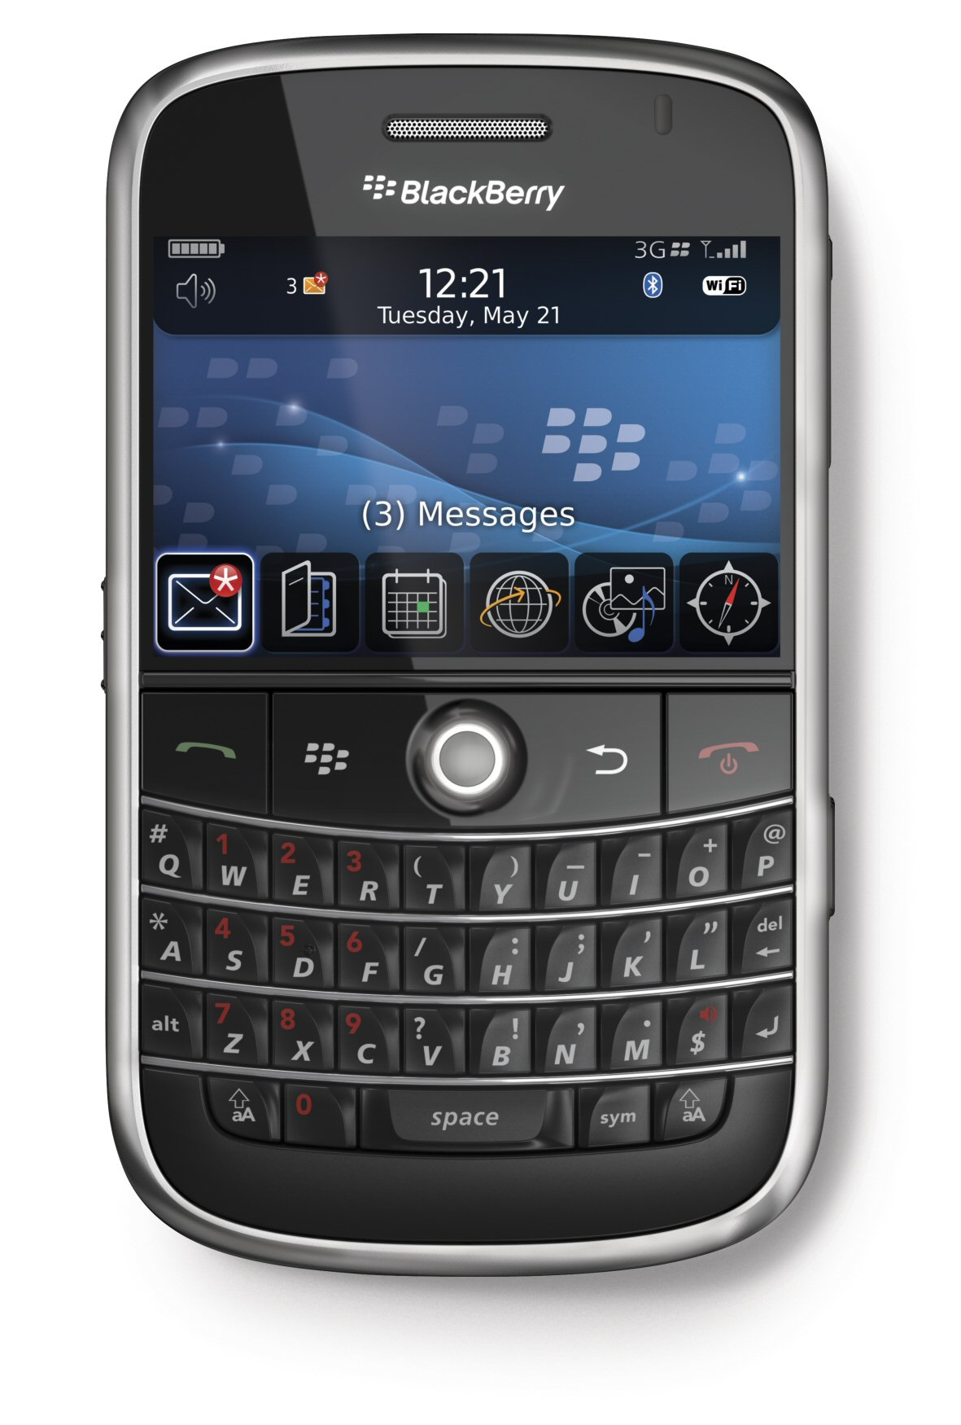

Slide 16
End of Activity

Slide 17

How was this presentation different from a typical presentation?
People
Information
CONVERSATION
PLANNING
PREPARING
Notes:
“again, this is obviously a powerpoint presentation, as you can see. But it is very different from the presentations you usually experience. What did you think of it?”
alive!”
“teamwork” that they find very “stimulating.” people describe the experience with words rarely used to describe a conventional powerpoint presentation, like “fun,” “curiosity,” “anticipation,” and “surprise.” the exercise instantly changes the tone and tenor of a group, opening up a degree of “imagination” that “overcomes staleness.” Ironically for a tool that is often blamed for shutting down people, this simple exercise easily opens them up and “brings out personality” for every person there in a way that many people say they don’t experience anywhere else.
“dependent on us to be here!” If you e-mailed the powerpoint file of the Visual Improv exercise to someone who was not in the room during the exercise, they would see only a set of slides with simple images and wonder what you were talk- ing about. the reality of what happened “in the moment” was precious and fleet- ing, created wholly from the personalities, voices, fast thinking, wit, and creativity of the people there. Because each person “can’t read ahead,” the experience is
by its nature unscripted and “unpredictable,” making it “intriguing” and incred ibly full of “suspense.” For some people, it was also “scary” because they did not know what they were going to say until it was their turn. the visual on the screen prompts the verbal narration, which demands that people be there to create the experience as they “improvise.” this is a practical demonstration of why we gather together to meet in the first place. there is an incredible amount of informationVisual Improvisation
that we communicate in person that simply cannot be captured in e-mail, on a piece of paper, or on a Web site—sometimes you really do have to be there.
FIgure 11-10 the BBp Visual Improv exercise unlocks creativity, spontaneity, and an abiding sense of camaraderie among the people in the room.
n “power of the image!” the shapes, colors, and variety of the images literally bring color into the room and help people tap into their “creative” sides. they prove that you “don’t need text” in order to communicate. almost like an elec- tronic theater set, the images on screen offered a “visual backdrop” that immersed the speaker in an interesting image. the images became a “visual trigger”—a springboard for people to transform photos of everyday objects into powerful and memorable story metaphors in the blink of an eye. this technique “brought out information” from people and provided a “clear direction” by using a “shift to story” instead of bulleted lists of text.
n “Focus on the speaker!” the Visual Improv exercise shifts the dynamics of the conventional relationship between a speaker and an audience as each person uses the screen as a “cue, not a cue card.” Once the audience sees the simple image, their attention quickly shifts to the person speaking. this creates a dependence on the speaker to extract the meaning from the screen. each person knows that he
Chapter 11 C-19
C-20 Chapter 11
A

Slide 18
PLANNING a presentation
Notes:
Let’s talk about the important steps to properly plan a presentation. This is where you should be spending 30% of your time, before you even start work using powerpoint.

Slide 19
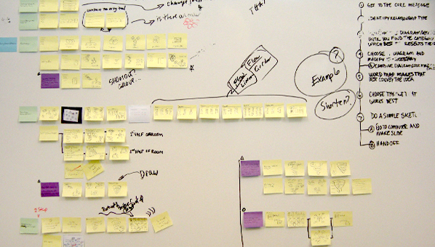
“Planning in Analog”
Carmine Gallo, Columnist for Businessweek
CONVERSATION
PLANNING
PREPARING
Notes:
First, allow yourself plenty of time. This is one of the most important activities you will do in your career, isn’t worth the time to properly prepare your presentation?
I urge you all to start planning with paper or stickie notes. I know this is very counterintuitive to how many of us plan presentations now.
The initial concept for Southwest Airlines was done on a cocktail napkin.
You should develop some techniques to storyboard your presentations.
I like to start writing my story in five basic steps, this follows Aristotle’s Outline for Persuasive Arguments:
1. Write the challenge to be faced, this should take on the essence of a passion statement.
2. What are the implications of this challenges?
3. Write the solution to these challenges.
4. Describe how this solution addresses the challenges.
5. Write a call to action.
The story will be expanded as storyboard the presentation.

Slide 20
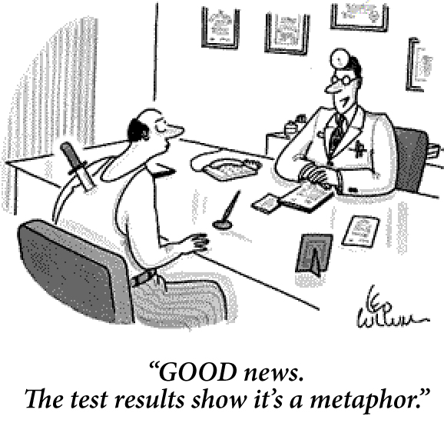
Use Metaphors
CONVERSATION
PLANNING
PREPARING
Notes:
Most people love metaphors. I am not particularly good at these off the cuff, so pre-planning metaphors for me is essential. Analogies are also useful.
Try to stay away from sports metaphors, some people are not sports fans.
Put your presentation thoughts in terms of very comprehendible metaphors or analogies that people can quickly grasp.
You are the sun in my sky
You are the light in my life
She is my East and my West, my compass.
Analogies
He fell for her like his heart was a mob informant, and she was the East River.
Even in his last years, Granddad had a mind like a steel trap, only one that had been left out so long it had rusted shut.

Slide 21
Use a Motif
Sandia’s requires THREE elements for R&A
Sandia National Laboratories is a multi-program laboratory managed and operated by Sandia Corporation, a wholly owned subsidiary of Lockheed Martin Corporation, for the U.S. Department of Energy’s National Nuclear Security Administration under contract DE-AC04-94AL85000.
CONVERSATION
PLANNING
PREPARING
Notes:
Use a motif. You’re only required to use three elements in a presentation, so you can easily add a motif.
My motif is at the bottom of the slides. It is being used so you can always think about what my location in the presentation..

Slide 22
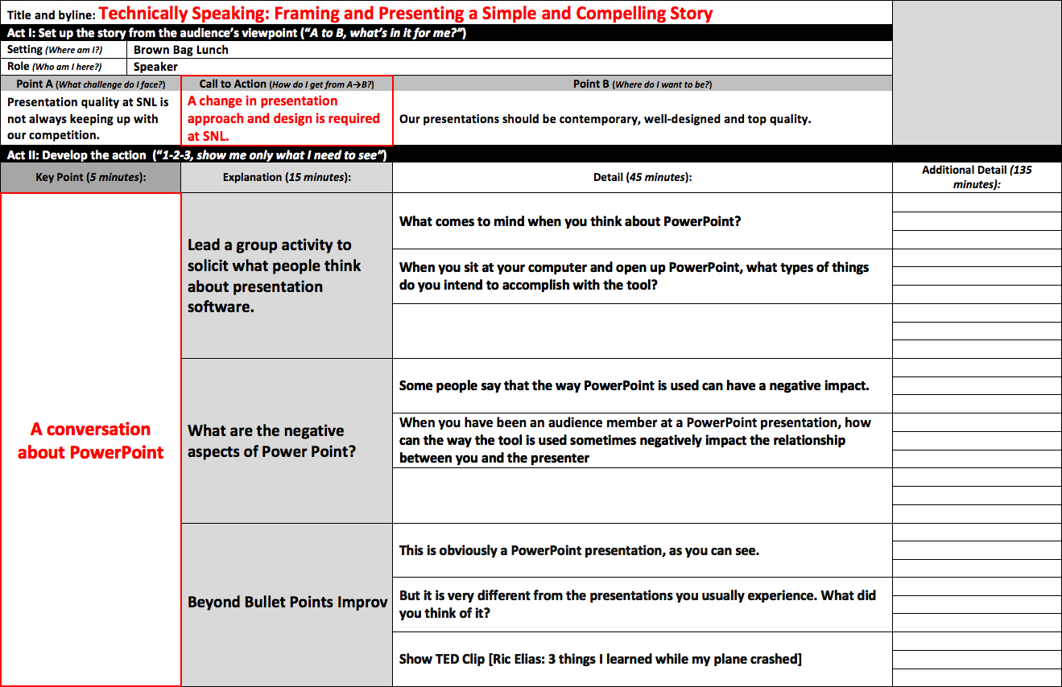
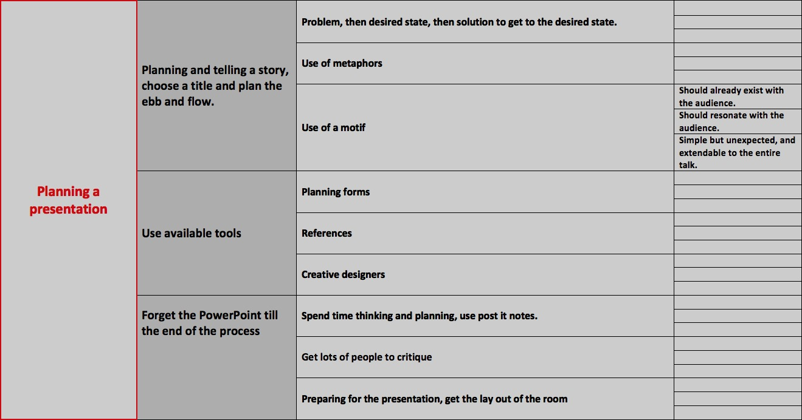
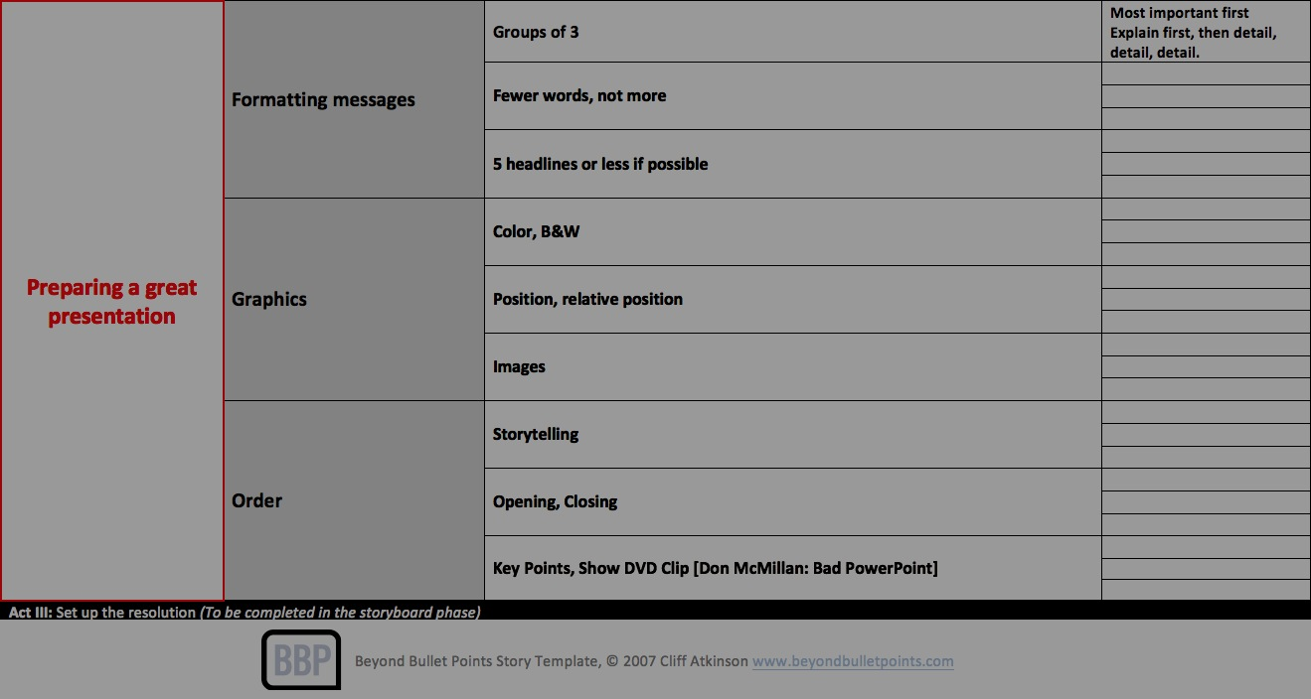
Presentation Templates
CONVERSATION
PLANNING
PREPARING
Notes:
Here is my storyboarding template for today’s presentation from Beyond Bullet Points, by Cliff Atkinson. Great book, fabulous ides.
These templates help you frame out a compelling and simple story.
It is also helpful to plan presentations of different lengths of time. Notice at the top, if you have 5 minutes, you can present 3 points. That is it.
If you have 15 minutes, you can present 3 points, with 3 supporting subpoints.
And so on.
Again, this follow Aristotle’s Outline for Persuasive Arguments.

Slide 23
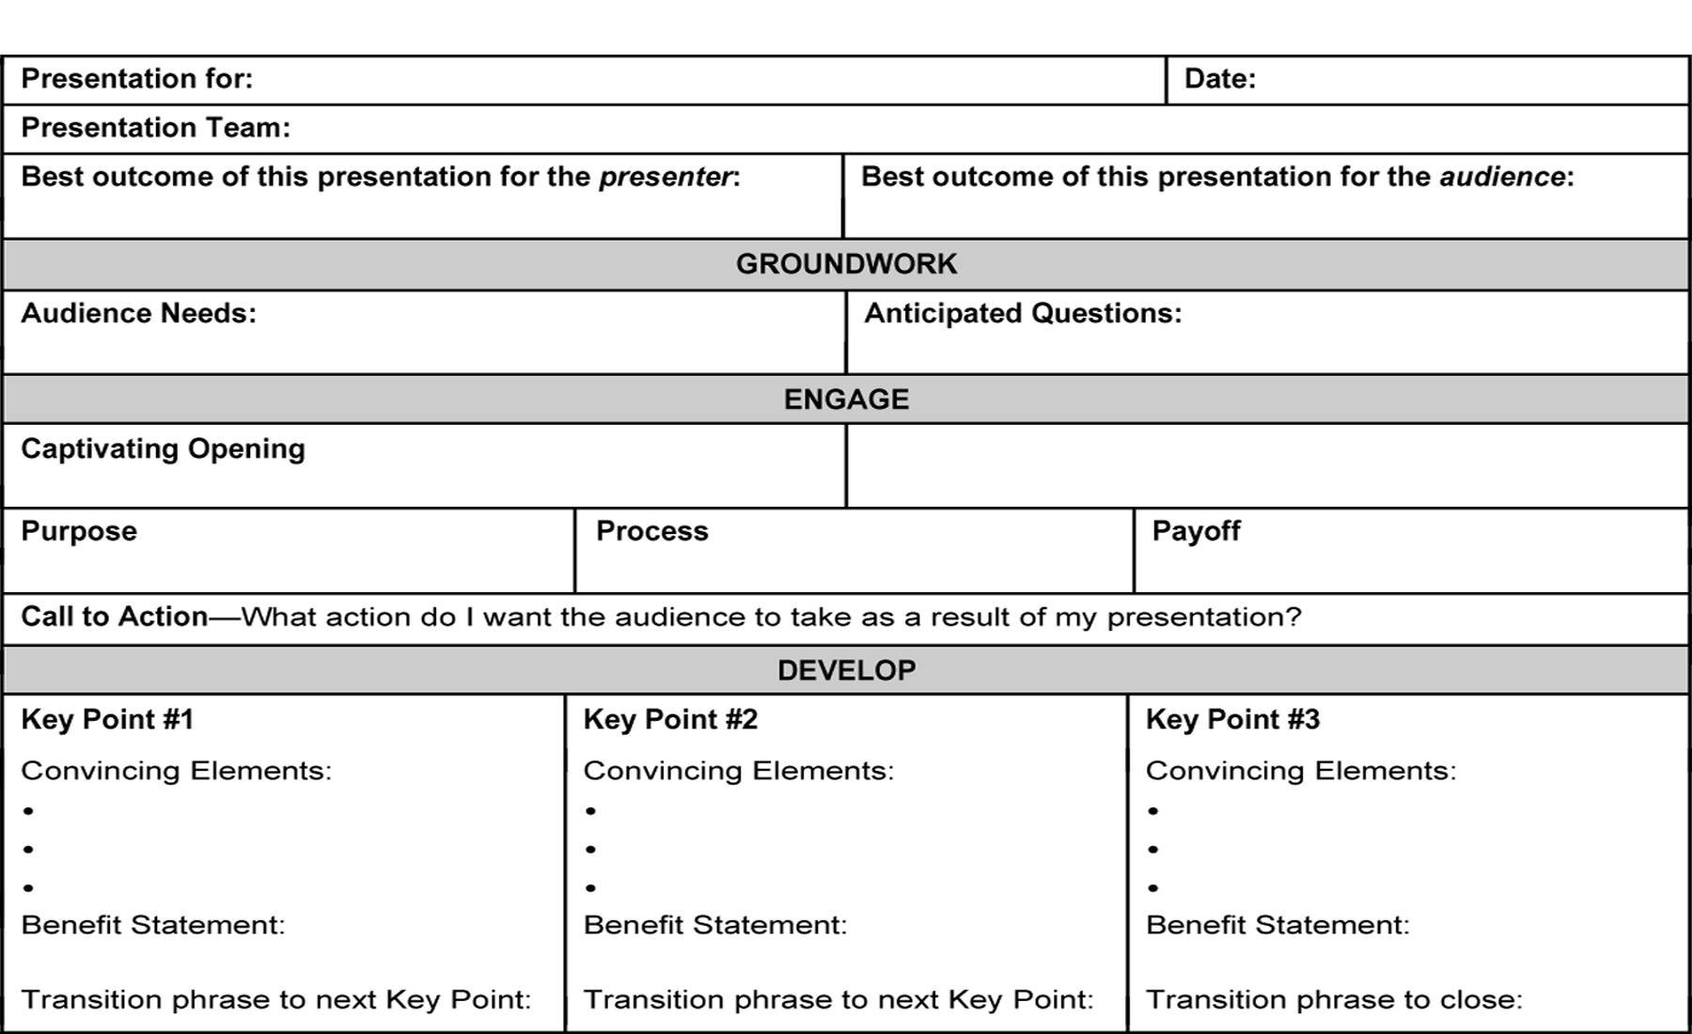
Planning Forms
CONVERSATION
PLANNING
PREPARING
Notes:
Here is another template by Judy Knoerle, who teaches effective presentation at Sandia. I recommend the class, Judy is a wonderful teacher.
It doesn’t matter what template you use, just use something other than PowerPoint.

Slide 24
Planning - Final Ideas
Plan in analog
Time
Input from others
CONVERSATION
PLANNING
PREPARING
Notes:
Let’s review the planning principles.
After you do your first draft, start reviewing your plans with others. See what they think. The more input you get on your plans, the better the presentation will be.

Slide 25
PREPARING a Great Presentation
Notes:
You’ve done all the planning, now is the time for presentation preparation.

Slide 26
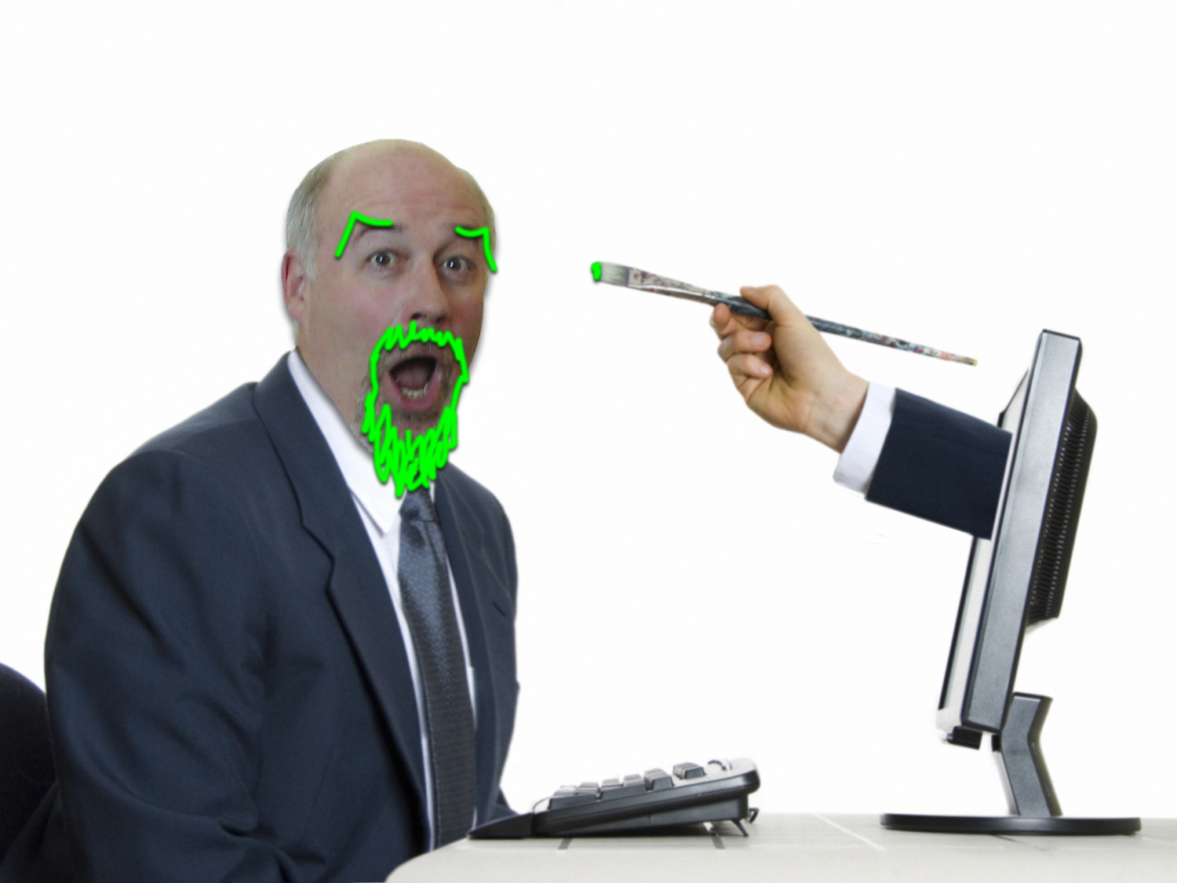
Team with a
Creative
CONVERSATION
PLANNING
PREPARING
Notes:
I’m a big believer in the idea that everyone is creative.
Some are more creative than others.
Seek out those that can help with color, placement of graphics, and readability of your presentation.
I work with Mona Aragon and Jason Bolles, Here Mona is having some fun with this presentation.

Slide 27
Message Mapping
Headlines, groups of THREE, no more than five
  Subgroups of THREE
    And so on depending on the length of your presentation
CONVERSATION
PLANNING
PREPARING
Notes:
I’ve mentioned message mapping previously. But here is what is exactly. It is used by most really proficient speakers. For example, Colin Powell is a big believer in this concept.
Now that you know about, listen to news stories, professional presentations, and proficient speakers. See how often this technique is used.

Slide 28
Speaking
Fewer words
Speak simply
Think Twitter, not War and Peace
CONVERSATION
PLANNING
PREPARING
Notes:
When you practice your talk-yes, you have to practice a number of times, think about these concepts.
Be efficient with your words, use Zippy words.
Speak as simply as possible so that everyone in the audience understands your points.

Slide 29
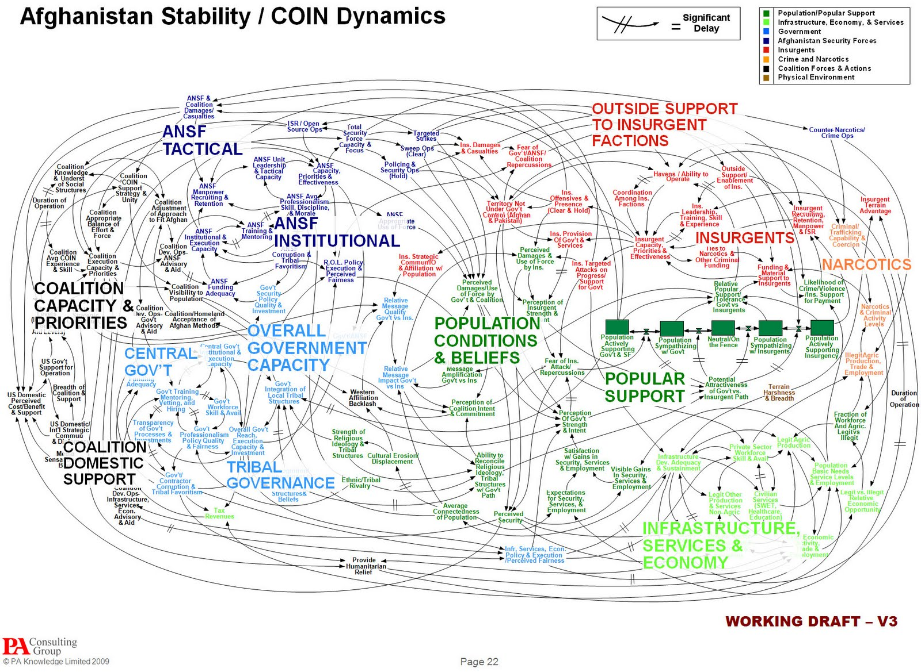
Slide Composition: BAD
CONVERSATION
PLANNING
PREPARING
Notes:
Let’s think about graphics. He is a recent one about military doctrine in Afghanistan.
Is this an effective graphic?

Slide 30

Slide Composition: GOOD
Port Selection
benefit
Better trade-offs in numbers of ports and required RPMs to number of containers monitored worldwide
how
Focus on shipping chokepoints of transshipment hubs
what
Re-evaluate Megaports Prioritization Model parameters and weightings
COUNTRY ENGAGEMENT
CONVERSATION
PLANNING
PREPARING
Notes:
Here is a much more effective slide that one of my folks did recently.
It has pleasing and meaningful graphics.
Contains just enough information.
The information is message mapped.

Slide 31

Make Numbers Meaningful
Notes:
Make numbers meaningful.
This is a Mandelbrot Fractal, as much a work of art as an equation.
The equation is z_{n+1} = z_{n}² + c

Slide 32
Charts Can be Effective
COMPANY GROWTH
236
New
Hires
2000
2011
CONVERSATION
PLANNING
PREPARING
Notes:
Use easy to understand charts. Someone should be able to figure out the essence of what you are communicating very quickly.
If it is too complicated, no one will be able to understand the nuances, much less the three points that are most important.

Slide 33

Storytelling
CONVERSATION
PLANNING
PREPARING
Notes:
Finally, you need to tell a story.
Humans love to hear stories. Think of the best technical presentations that you’ve ever heard. They were great stories. There was a challenge, no solution in sight, and then suddenly someone figured out a solution. The story behind every great discovery is fascinating to us all.
Think about the quest to solve Fermat’s Last Theorem, how Andrew Wild worked for years to yield a solution.

Slide 34

Describe Problem, Adversary or Dilemma
CONVERSATION
PLANNING
PREPARING
Notes:
There may be an enemy to a story. I always love having Microsoft be a villain. Because there is an obvious savior.

Slide 35

Describe Solution or the Protagonist
CONVERSATION
PLANNING
PREPARING
Notes:
I loved Apple Products for years.

Slide 36

Captivating
Opening and
Closing
Notes:
Work hard on a great opening to your talk. Remember when Steve Jobs introduced the iPhone. Probably one of the best product openings ever done. Its not just a phone, not just a iPod, not just an internet device, it all three in one!
The other thing that Jobs does well is to simplify everything he does. When Phil Knight of Nike called him for advice, Jobs told him to get rid of the junk, and focus only on Nike’s great products. Knight thought he was kidding. Jobs wasn’t laughing.
Jobs often tells his staff, when there done preparing presentations, go back over them one more time and remove items that aren’t absolutely needed for the presentation.

Slide 37

Ric Elias: “3 things I learned while my plane crashed”
Notes:
I want to end today with a great presentation that I hope will inspire you. It emphasizes many of the points I discussed today, and does not use any slides.

Slide 38
THANK YOU!

